Slide 1
Blazing the Web - Building Web Applications in C#
Jason Bock
Practice Lead

Slide 2
Personal Info
http://www.magenic.com
http://www.jasonbock.net
https://www.twitter.com/jasonbock
https://www.github.com/jasonbock
jasonb@magenic.com

Slide 3
Downloads
https://github.com/JasonBock/BlazingTheWeb
https://github.com/JasonBock/Presentations

Slide 4
Overview
History
WebAssembly
Blazor
Final Thoughts
Conclusion
Remember…
https://github.com/JasonBock/BlazingTheWeb
https://github.com/JasonBock/Presentations

Slide 5

History
http://foodnetwork.sndimg.com/content/dam/images/food/fullset/2008/3/5/0/NY0100_BBQ-Spaghetti.jpg#Spaghetti%20811x608
Notes:
JavaScript was meant to be a scripting languages for documents. Pushing it any farther than that and it was difficult to prevent spaghetti code from happening.

Slide 6





History
Notes:
Over time, developers creates packages and modules to make web development easier.

Slide 7


History
Notes:
Ironically, JavaScript started to spread everywhere, and has become as close to “one language to rule them all” as any other has become.

Slide 8




History
Notes:
Now, for some….this isn’t a great thing. Sure, JavaScript has some good parts, but people enjoy other languages. However, this is still transpiled.

Slide 9

History
<script type="text/csharp" src="code.cs"></script>
<script type="text/ruby" src="code.rb"></script>
<script type="text/python" src="code.py"></script>
Notes:
And these developers would probably love to reuse their code in the browser (or Node.js), but there’s no choice. The ONLY language that the web understands is JavaScript….at least until WebAssembly.

Slide 10









History
Notes:
This is kind of weird when you think about it. Most languages can work anywhere, but JavaScript has pushed web development to a mono-language culture. As you’ll see, this is no longer the case.

Slide 11

History
http://blog.cmaresources.org/wp-content/uploads/2012/05/speed2.jpg
Notes:
So, sure, you make JavaScript work. But….there’s performance. JavaScript is an interpreted language. You can use minifiers to reduce the amount of textural JS that you ship to a browser or run in Node, but it has to be interpreted on the fly. There’s a performance cost involved that can’t be eliminated with this approach.

Slide 12
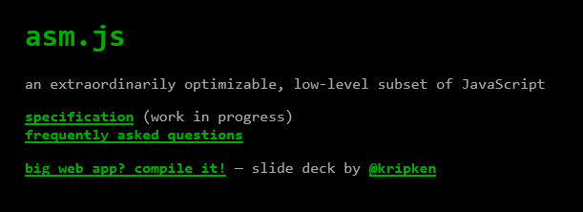

History
http://asmjs.org
http://kripken.github.io/emscripten-site/
Notes:
Not to be deterred, the JS community came up with asm.js and emscripten.

Slide 13
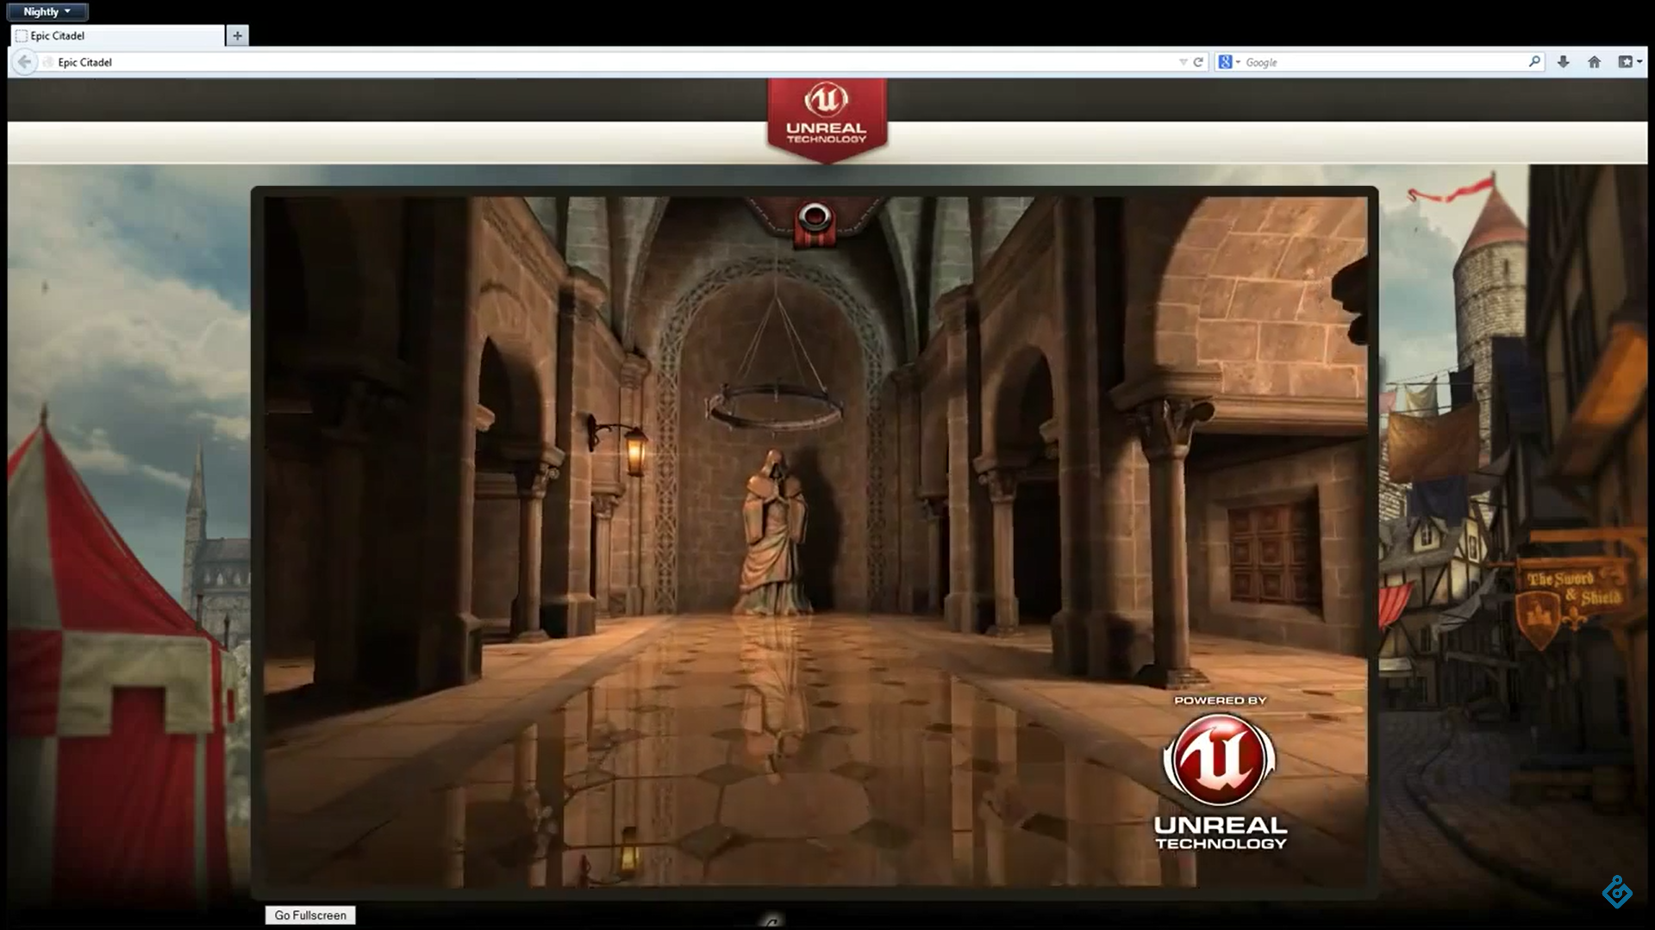
History
https://youtu.be/nB9Pm9Mr7xo
Notes:
And then you can do an Unreal demo in the browser, which is actually pretty impressive. But none of this is standardized.

Slide 14

WebAssembly
https://github.com/carlosbaraza/web-assembly-logo
Notes:
Enter WebAssembly

Slide 15
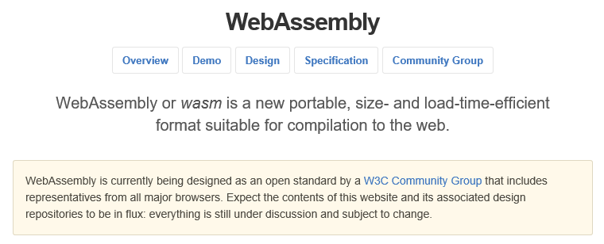
WebAssembly
http://webassembly.github.io/
http://webassembly.github.io/
Notes:
WebAssembly is fundamentally the same thing as asm.js, but done as an open standard for web developers.

Slide 16

WebAssembly
https://twitter.com/linclark/status/836609222733348864/photo/1
Notes:
Everyone is implementing it

Slide 17
WebAssembly
Efficient and fast
Safe
Open and debuggable
Part of the open web platform
Notes:
These come directly from the WebAssembly site:
Overview
•Efficient and fast: The wasm AST is designed to be encoded in a size- and load-time-efficient binary format. WebAssembly aims to execute at native speed by taking advantage of common hardware capabilities available on a wide range of platforms.
•Safe: WebAssembly describes a memory-safe, sandboxed execution environment that may even be implemented inside existing JavaScript virtual machines. When embedded in the web, WebAssembly will enforce the same-origin and permissions security policies of the browser.
•Open and debuggable: WebAssembly is designed to be pretty-printed in a textual format for debugging, testing, experimenting, optimizing, learning, teaching, and writing programs by hand. The textual format will be used when viewing the source of wasm modules on the web.
•Part of the open web platform: WebAssembly is designed to maintain the versionless, feature-tested, and backwards-compatible nature of the web. WebAssembly modules will be able to call into and out of the JavaScript context and access browser functionality through the same Web APIs accessible from JavaScript. WebAssembly also supports non-web embeddings.

Slide 18
Demo: Targeting WASM
Blazing the Web – Building Web Applications in C#
Notes:
Let’s do Collatz in WebAssembly

Slide 19
WebAssembly
Greg Reimer, Web Developer
“We won't need to learn wasm any more than C++ programmers need to learn assembly. In the same vein, to remain competitive as developers, we'll need to learn how it fits in our toolchains, which means getting nice and cozy with it. In other words, we'll all be generating wasm, but few of us will actually be writing or debugging it directly.”
https://www.quora.com/What-does-WebAssembly-mean-for-those-who-are-currently-learning-web-development
Notes:
In the end, most developers really won’t have to worry about wasm any more than they do about assembly, .NET IL, Java byte codes, etc.

Slide 20
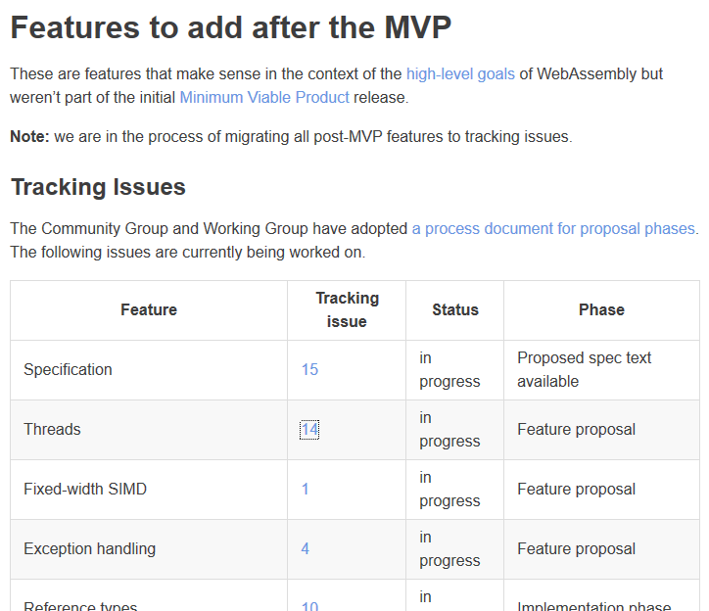
WebAssembly
https://webassembly.org/docs/future-features/
Notes:
Note that WA needs more features, like threads, native DOM support, etc. You can find out their roadmap here.

Slide 21
Blazor
C
C++
Rust
Swift
Go
Ruby
Dart
Python
Notes:
So, it’s very cool to see that other languages are targeting WASM.

Slide 22

Blazor
?
?
?
?
?
Notes:
But what about C#?

Slide 23
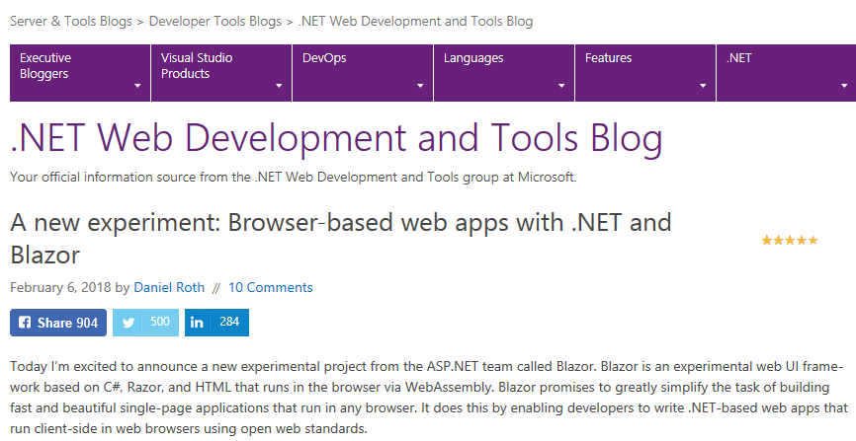
Blazor
https://blogs.msdn.microsoft.com/webdev/2018/02/06/blazor-experimental-project/
Notes:
People are already creating ways to run C# in the browser. For example, there’s Blazor. And what’s exciting about this is that, it’s no longer a prototype. It’s moved to the ASP.NET team as an experimental feature!

Slide 24
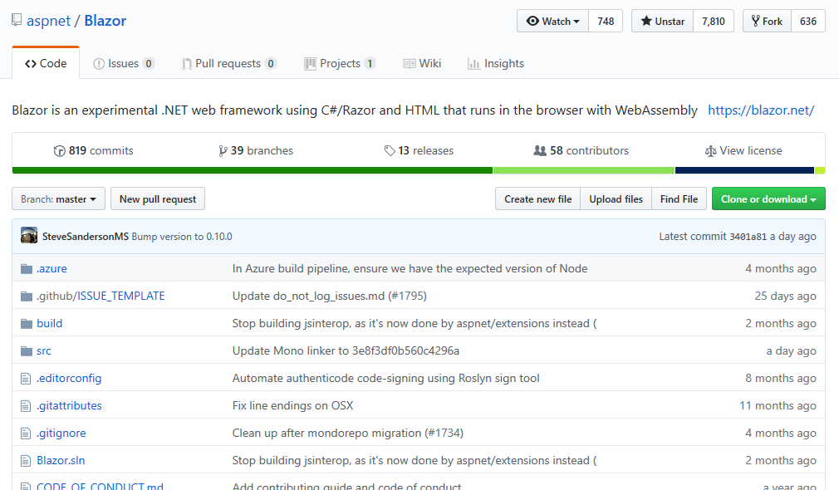
Blazor
https://github.com/aspnet/blazor
Notes:
Here’s the repo that you can get.

Slide 25
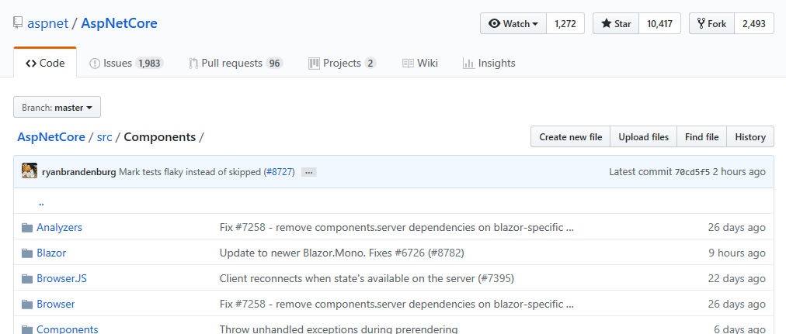
Blazor
https://github.com/aspnet/AspNetCore/tree/master/src/Components
Notes:
Note that it’s moving.

Slide 26


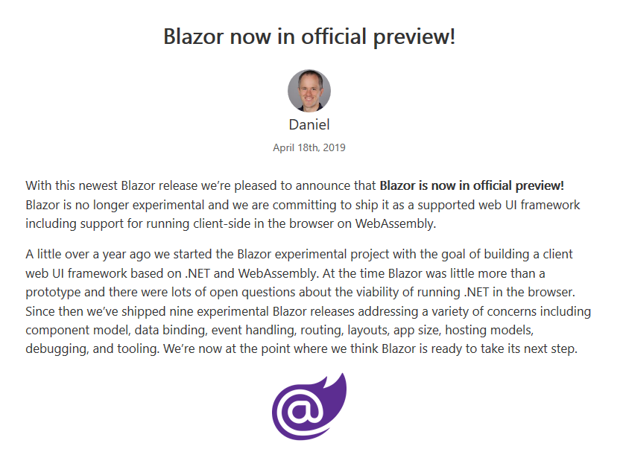


Blazor
https://devblogs.microsoft.com/aspnet/blazor-now-in-official-preview/
http://clipart-library.com/clipart/872445.htm, http://clipart-library.com/clipart/1179447.htm
http://clipart-library.com/clipart/1179466.htm, http://clipart-library.com/clipart/1271580.htm
Notes:
This….is….HUGE!!!!!

Slide 27
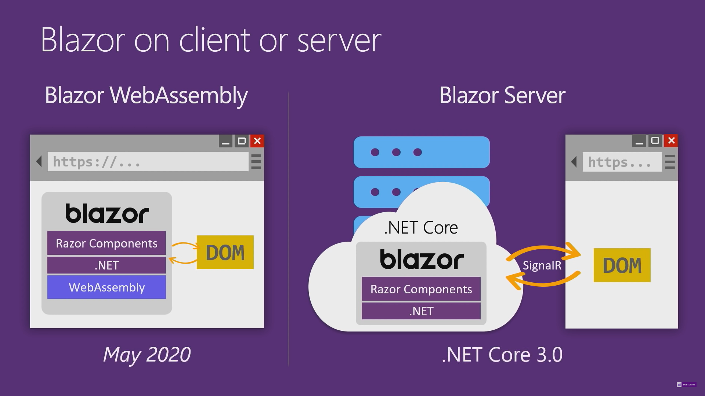
Blazor
https://www.youtube.com/watch?v=MetcuX1OHD0
Notes:
Blazor server-side comes with .NET Core 3.0. Client-side is scheduled May 2020 (that’s where the cool stuff is)

Slide 28
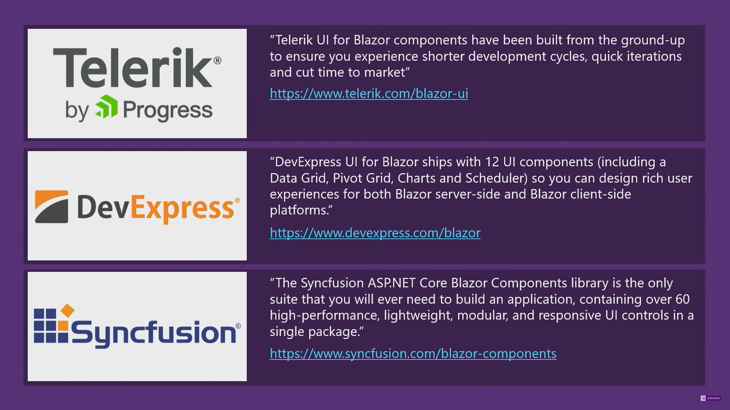
Blazor
https://www.youtube.com/watch?v=MetcuX1OHD0
Notes:
Third-party component vendors are already supporting Blazor.

Slide 29
Blazor
Projects
JS Interop
Routing
Components
Eventing
State
Testing
Threading
Hosting
Notes:
Projects – what different project templates are there, point out key aspects
JS Interop – interacting with JS is essential in the foreseeable future. Show Chart.js and geolocation
Routing – using route information to display information and pass data to the component
Components – what are they, what’s the lifecycle, how is code and UI handled, etc.
Eventing – think event aggregation, how do components “talk” to other parts of the application seamlessly
State – how does Blazor handle application state
Testing – unit, integration, also talk about MV* approaches
Threading – doing work “in the background”, how does that work
Hosting – think Blazor mobile here

Slide 30
Demo: Targeting Blazor
Blazing the Web – Building Web Applications in C#
Notes:
Let’s do Collatz in WebAssembly

Slide 31

Final Thoughts
https://formula1.files.wordpress.com/2016/05/season2016_race5_wallpapers_09.jpg
Notes:
WebAssembly is all about speed.

Slide 32

Final Thoughts
http://thebridge-can.com/wp-content/uploads/2014/09/Braveheart-Freedom-Slide.jpg
Notes:
WebAssembly is also about freedom.

Slide 33
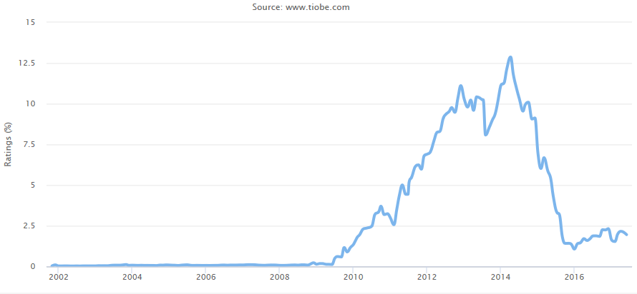



Final Thoughts
Notes:
Choice is good. Sometimes it can be overwhelming, but if developers can choose a language that they are comfortable with and feel productive in, the environment really shouldn’t be a constraint, especially on the web. With Swift (and to some degree, Xamarin), it’s clear that developers are starting to move away from Objective-C to other choices.

Slide 34
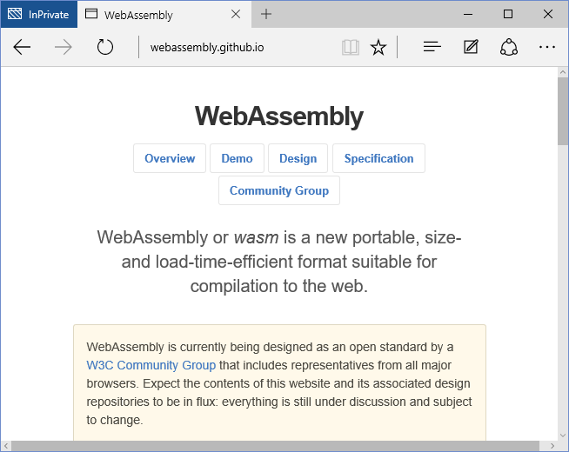



Final Thoughts
Notes:
Will this happen when wasm becomes mainstream? Time will tell….

Slide 35
Final Thoughts
WebAssembly for .NET - https://github.com/RyanLamansky/dotnet-webassembly
wasm2cil - https://github.com/ericsink/wasm2cil/
http://thebridge-can.com/wp-content/uploads/2014/09/Braveheart-Freedom-Slide.jpg
Notes:
And it’s possible to use code from ANY language if it targets WASM. This is language interoperability at a native level that is much simpler than p-invokes.

Slide 36
Demo: Using WASM in .NET
Blazing the Web – Building Web Applications in C#
Notes:
Let’s do Collatz in WebAssembly

Slide 37






Conclusion
Notes:
Blazor has the potential to be the cross-platform UI strategy from MS, where you can build Uis for the web, or Electron, or native (Flutter, Electron, Xamarin, etc.).

Slide 38




Conclusion
Notes:
….but I’m confident, especially now that Blazor is supported by MS. The future is looking very bright!

Slide 39
Blazing the Web - Building Web Applications in C#
Remember:
https://github.com/JasonBock/BlazingTheWeb
https://github.com/JasonBock/Presentations
References in the notes on this slide
Jason Bock
Practice Lead
Notes:
Performance Links/Demos:
Blazor Geolocation updated - https://aspnetmonsters.com/2018/11/2018-11-27-blazor-geolocation-updated/
Can I Use Wasm: http://caniuse.com/#feat=wasm
Hashing - https://antelle.github.io/argon2-browser/
Animation Demo - http://aws-website-webassemblyskeletalanimation-ffaza.s3-website-us-east-1.amazonaws.com/
Autocad Client360 - https://client.autocad360.com/#/filemanager.html
WebAssembly: A New Hope - https://pspdfkit.com/blog/2017/webassembly-a-new-hope/
CoreRT: C:\corert\tests\src\Simple\HelloWasm\HelloWasm.csproj
Websight.js - https://www.websightjs.com/
OouiChat - http://oouichat.azurewebsites.net/
Benchmark.NET in Uno - https://benchmarkdotnet.platform.uno/
Blazing Pizza - https://aka.ms/blazorworkshop
Build your own WebAssembly Compiler - https://blog.scottlogic.com/2019/05/17/webassembly-compiler.html
References:
Blazor - https://blazor.net/ (https://dotnet.microsoft.com/apps/aspnet/web-apps/client)
A new experiment: Call .NET gRPC services from the browser with gRPC-Web - https://devblogs.microsoft.com/aspnet/grpc-web-experiment/
Using gRPC-Web with Blazor WebAssembly - https://blog.stevensanderson.com/2020/01/15/2020-01-15-grpc-web-in-blazor-webassembly/
Blazor in more depth - Ryan Nowak & Steve Sanderson - https://www.youtube.com/watch?v=QnBYmTpugz0
Blazor, a new framework for browser-based .NET apps - Steve Sanderson - https://www.youtube.com/watch?v=Khn7sDUSEJM
Blazor.Animate - https://github.com/mikoskinen/Blazor.Animate
Mobile Blazor Bindings – Getting Started + Why You Should Care - https://www.dylanberry.com/2020/02/05/mobile-blazor-bindings-getting-started-why-you-should-care/
Fragment Routing with Blazor - https://chrissainty.com/fragment-routing-with-blazor/
Blazor by Example - Build a simple traffic light - https://jonhilton.net/blazor-traffic-light/
Reuse Blazor WASM UI in Blazor Server - http://www.appvnext.com/blog/2020/2/2/reuse-blazor-wasm-ui-in-blazor-server
Blazor WebAssembly 3.2.0 Preview 1 release now available - https://devblogs.microsoft.com/aspnet/blazor-webassembly-3-2-0-preview-1-release-now-available/
Blazor by Example - Build a simple markdown editor - https://jonhilton.net/blazor-markdown-editor/
6 Blazor component libraries to speed up your development - https://jonhilton.net/blazor-component-libraries/
The Future of Blazor is Native Apps - https://medium.com/young-coder/the-future-of-blazor-is-native-apps-9f4a510acdd5
Deploy a Blazor WASM site to Azure Storage using GitHub Actions - https://timheuer.com/blog/deploy-blazor-app-to-azure-using-github-actions/
Blazor in more depth - https://www.youtube.com/watch?v=dCgqTDki-VM
Using WebAssembly from .NET with Wasmtime - https://hacks.mozilla.org/2019/12/using-webassembly-from-dotnet-with-wasmtime/
Blazor University - http://blazor-university.com/
Hosting a Containerized Client Side Blazor Applications On Azure - https://medium.com/@waelkdouh/hosting-containerized-client-side-blazor-applications-on-azure-e090af738619
Desktop applications with Bolero and WebWindow - https://tarmil.fr/article/2019/11/24/bolero-webwindow
INotifyPropertyChanged behavior in Blazor Components - http://www.appvnext.com/blog/2019/11/28/inotifypropertychanged-behavior-in-blazor-components
What is Blazor? A Tutorial on Building Web Apps with Authentication - https://auth0.com/blog/what-is-blazor-tutorial-on-building-webapp-with-authentication/
An In-depth Look at Routing in Blazor - https://chrissainty.com/an-in-depth-look-at-routing-in-blazor/
A New Era of Productivity with Blazor - https://www.codemag.com/article/1911052?utm_source=twitter&utm_medium=social-owned&utm_campaign=sm-articles
Blazor Component Lifecycle Diagram - https://knowledge-base.havit.eu/2019/11/02/blazor-component-lifecycle-diagram/
An Introduction to Building Applications with Blazor - http://blazorhelpwebsite.com/Market/Books/AnIntroductiontoBuildingApplicationswithBlazor.aspx
Exploring lighter alternatives to Electron for hosting a Blazor desktop app - http://blog.stevensanderson.com/2019/11/01/exploring-lighter-alternatives-to-electron-for-hosting-a-blazor-desktop-app/
Webassembly for C, Rust, Go, and C# in 45 Minutes - https://dev.to/jeremylikness/webassembly-for-c-rust-go-and-c-in-45-minutes-58md
ASP.NET Core updates in .NET Core 3.1 Preview 1 - https://devblogs.microsoft.com/aspnet/asp-net-core-updates-in-net-core-3-1-preview-1/
Blazor Server in .NET Core 3.0 scenarios and performance - https://devblogs.microsoft.com/aspnet/blazor-server-in-net-core-3-0-scenarios-and-performance/
The Future of Blazor on the Client - https://www.youtube.com/watch?v=qF6ixMjCzHA
The Blazor Bet - https://odetocode.com/blogs/scott/archive/2019/09/24/the-blazor-bet.aspx
Free Blazor Training Course - https://www.devexpress.com/support/training/blazor/
Blazor Error Handling OwningComponentBase and EF Core Tracking - http://blazorhelpwebsite.com/Blog/tabid/61/EntryId/4353/Blazor-Error-Handling-OwningComponentBase-and-EF-Core-Tracking.aspx
File uploads with Blazor - https://blog.stevensanderson.com/2019/09/13/blazor-inputfile/
Unit testing Blazor components - a prototype - http://blog.stevensanderson.com/2019/08/29/blazor-unit-testing-prototype/
Faster Fractals with Multi-Threaded WebAssembly - https://blog.scottlogic.com/2019/07/15/multithreaded-webassembly.html
10 Top Blazor Tools Just a NuGet Away - https://visualstudiomagazine.com/articles/2019/06/04/blazor-nuget.aspx
Building a C# Interactive shell in a browser with Blazor (WebAssembly) and Roslyn - https://www.strathweb.com/2019/06/building-a-c-interactive-shell-in-a-browser-with-blazor-webassembly-and-roslyn/
Full stack web development with ASP.NET Core 3.0 and Blazor - https://www.youtube.com/watch?v=y7LAbdoNBJA
Blazor now in official preview! - https://devblogs.microsoft.com/aspnet/blazor-now-in-official-preview/
ASP.NET Core updates in .NET Core 3.0 Preview 4 - https://devblogs.microsoft.com/aspnet/asp-net-core-updates-in-net-core-3-0-preview-4/
Updated Razor support in Visual Studio Code, now with Blazor support - https://devblogs.microsoft.com/aspnet/updated-razor-support-in-visual-studio-code-now-with-blazor-support/
Using JavaScript Interop in Razor Components and Blazor - https://chrissainty.com/using-javascript-interop-in-razor-components-and-blazor/
Using Blazor to Build a Client-Side Single-Page App with .NET Core - https://exceptionnotfound.net/using-blazor-to-build-a-client-side-single-page-app-with-net-core/
Blazor, a new framework for browser-based .NET apps - Steve Sanderson - https://www.youtube.com/watch?v=uW-Kk7Qpv5U
Working with the View in Blazor MVVM : functions{} vs code behind vs ViewModel - https://itnext.io/working-with-the-view-in-blazor-mvvm-functions-vs-code-behind-vs-viewmodel-ed3508dba86a
Running WebAssembly and WASI with .NET - https://ericsink.com/entries/wasm_wasi_dotnet.html
Blazor: Implementing Client Side Search As You Type Using bind-value-oninput - https://scottsauber.com/2019/03/25/blazor-implementing-client-side-search-as-you-type-using-bind-value-oninput/
Exploring Blazor with Visual Studio 2019 - https://devblogs.microsoft.com/premier-developer/exploring-blazor-with-visual-studio-2019/
Blazor 0.9.0 experimental release now available - https://devblogs.microsoft.com/aspnet/blazor-0-9-0-experimental-release-now-available/
What’s the Difference Between Razor and Blazor?!? - https://espressocoder.com/2019/02/21/whats-the-difference-between-razor-and-blazor/
Replacing a hot path in your app's JavaScript with WebAssembly - https://developers.google.com/web/updates/2019/02/hotpath-with-wasm
WasmRoslyn - https://kjpou1.github.io/WasmRoslyn/
Blazor - app building workshop - https://github.com/dotnet-presentations/blazor-workshop/
BenchmarkDotNet in WebAssembly - https://twitter.com/jlaban/status/1089160316112523266/photo/1
Steve Sanderson - Blazor, a New .NET Single Page Application Framework - https://www.youtube.com/watch?v=qrf3OrLHeFI
Doom3 - http://continuation-labs.com/d3wasm/
.NET Core - What's Coming in .NET Core 3.0 - https://msdn.microsoft.com/en-us/magazine/mt848631
C# and Blazor Compilation inside Browser - https://www.samprof.com/2018/12/15/compile-csharp-and-blazor-inside-browser-en
Blazor: Working with Events - https://visualstudiomagazine.com/articles/2018/10/01/blazor-event-handling.aspx
Blazor Q&A with Microsoft's Daniel Roth - https://www.telerik.com/blogs/blazor-qa-with-microsofts-daniel-roth
WebAssembly’s post-MVP future: A cartoon skill tree - https://hacks.mozilla.org/2018/10/webassemblys-post-mvp-future/
A Nicer Looking Blazor Loading Page - http://lightswitchhelpwebsite.com/Blog/tabid/61/EntryId/4315/A-Nicer-Looking-Blazor-Loading-Page.aspx
Calls between JavaScript and WebAssembly are finally fast - https://hacks.mozilla.org/2018/10/calls-between-javascript-and-webassembly-are-finally-fast-🎉/
Integrating JavaScript and C# in the Browser: Beyond the Basics with Blazor - https://visualstudiomagazine.com/articles/2018/09/01/integrating-javascript-csharp.aspx
Security Chasms of WASM - https://i.blackhat.com/us-18/Thu-August-9/us-18-Lukasiewicz-WebAssembly-A-New-World-of-Native_Exploits-On-The-Web-wp.pdf
FlightFinder: https://github.com/aspnet/samples/tree/master/samples/aspnetcore/blazor/FlightFinder
Learn Blazor: https://learn-blazor.com/
Blazor repo - https://github.com/aspnet/blazor
Blazor Extensions - https://github.com/BlazorExtensions
Blazor: .NET in the Browser, Part 1 - https://dzone.com/articles/blazor-net-in-the-browser-part-1
A new experiment: Browser-based web apps with .NET and Blazor - https://blogs.msdn.microsoft.com/webdev/2018/02/06/blazor-experimental-project/
Blazor: a technical introduction - http://blog.stevensanderson.com/2018/02/06/blazor-intro/
Understanding Server-Side Blazor: https://www.c-sharpcorner.com/article/understanding-server-side-blazor/
Re-Assembling the Web with Web Assembly and Blazor - https://www.codemag.com/article/1809061
Writing a Blazor App: https://davidpine.net/blog/blazing-chuck/
Integrating Blazor and JavaScript Code: https://visualstudiomagazine.com/articles/2018/08/01/integrating-blazor-javascript.aspx
Under the hood : an introduction to Uno Platform - https://medium.com/@unoplatform/under-the-hood-an-introduction-to-uno-platform-6064a765d6aLife - A secure WebAssembly VM Web Assembly and Blazor: Re-assembling the Web - https://weblog.west-wind.com/posts/2018/Jul/31/Web-Assembly-and-Blazor-Reassembling-the-Web
Blazor, a new framework for browser-based .NET apps - Steve Sanderson - https://www.youtube.com/watch?v=JU-6pAxqAa4
Runny: Blazor + Roslyn - https://github.com/Suchiman/Runny
Blazor Bits - blazorbits.net
Blazor, Razor, WebAssembly, and Mono: How the pieces fit together - https://daveaglick.com/posts/blazor-razor-webassembly-and-mono
Blazor 0.2.0 release now available - https://blogs.msdn.microsoft.com/webdev/2018/04/17/blazor-0-2-0-release-now-available/
Blazor demo site: https://blazor-demo.github.io/
Running Blazor on Mono in the browser - http://blog.stevensanderson.com/2017/11/05/blazor-on-mono/
WebAssembly and Blazor with Steve Sanderson - http://www.dotnetrocks.com/?show=1455
Web Apps can’t really do *that*, can they? - Steve Sanderson - https://www.youtube.com/watch?v=MiLAE6HMr10
DotNetAnywhere - https://github.com/chrisdunelm/DotNetAnywhere
.NET and WebAssembly - Is this the future of the front-end? - https://www.hanselman.com/blog/NETAndWebAssemblyIsThisTheFutureOfTheFrontend.aspx
Uno Platform - The UWP Bridge for iOS, Android and WebAssembly - https://github.com/nventive/Uno
Uno Playground - http://platform.uno/Playground/index.html
Ooui.Wasm - .NET in the browser - http://praeclarum.org/post/171899388348/oouiwasm-net-in-the-browser
WebAssembly: Neither Web, Nor Assembly, but Revolutionary - https://www.javascriptjanuary.com/blog/webassembly-neither-web-nor-assembly-but-revolutionary

